Slide 1

DSP SAS project
Car Insurance Claim Prediction
Prepared by: Albert Zihan Zeng

Slide 2


Agenda
Introduction
EDA(exploratory data analysis)
Data preparation
Modeling
Model evaluation
Conclusion

Slide 3
Introduction
This presentation delves into a comprehensive yearly car insurance dataset, featuring 19 key features, including 18 logs and 10000 rows. The dataset downloaded from Kaggle website. https://www.kaggle.com/datasets/sagnik1511/car-insurance-data/data.
Business question?
Can predictive models be developed to forecast the likelihood of an individual filing an insurance claim based on their profile?
Objectives:
Our primary objective is developing a model to predict insurance claim and discern patterns in customer behavior related to insurance claims. By leveraging advanced tools, we aim to extract valuable insights for the insurance industry
Field | Explanation
AGE | Age of the individual
GENDER | Gender of the individual (e.g., male, female)
RACE | Racial background of the individual
DRIVING_EXPERIENCE | Years of driving experience
EDUCATION | Educational level attained (e.g., high school, university)
INCOME | Annual income level
CREDIT_SCORE | Numeric representation of creditworthiness
VEHICLE_OWNERSHIP | Ownership status of the vehicle (0 - No, 1 - Yes)
VEHICLE_YEAR | Year of manufacturing of the vehicle
MARRIED | Marital status (0 - No, 1 - Yes)
CHILDREN | Presence of children (0 - No, 1 - Yes)
POSTAL_CODE | Postal code of the individual's residence
ANNUAL_MILEAGE | Annual mileage driven
SPEEDING_VIOLATIONS | Number of recorded speeding violations
DUIS | Number of Driving Under the Influence incidents
PAST_ACCIDENTS | Number of past accidents involving the individual
OUTCOME | Insurance claim outcome (1 - Claim, 0 - No claim)

Slide 4
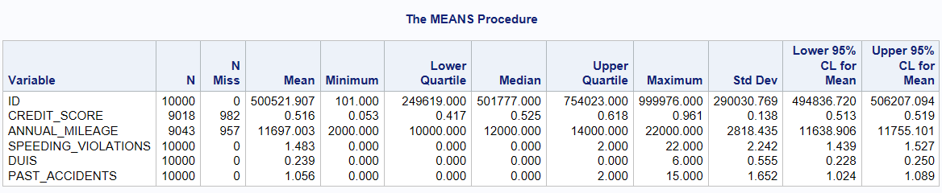
EDA – Numeric Variables
10000 observations
Missing values in CREDIT_SCORE and ANNUAL_MILEAGE
CREDIT_SCORE ranges from 0.053 to 0.961
ANNUAL_MILEAGE ranges from 2000 to 22000

Slide 5
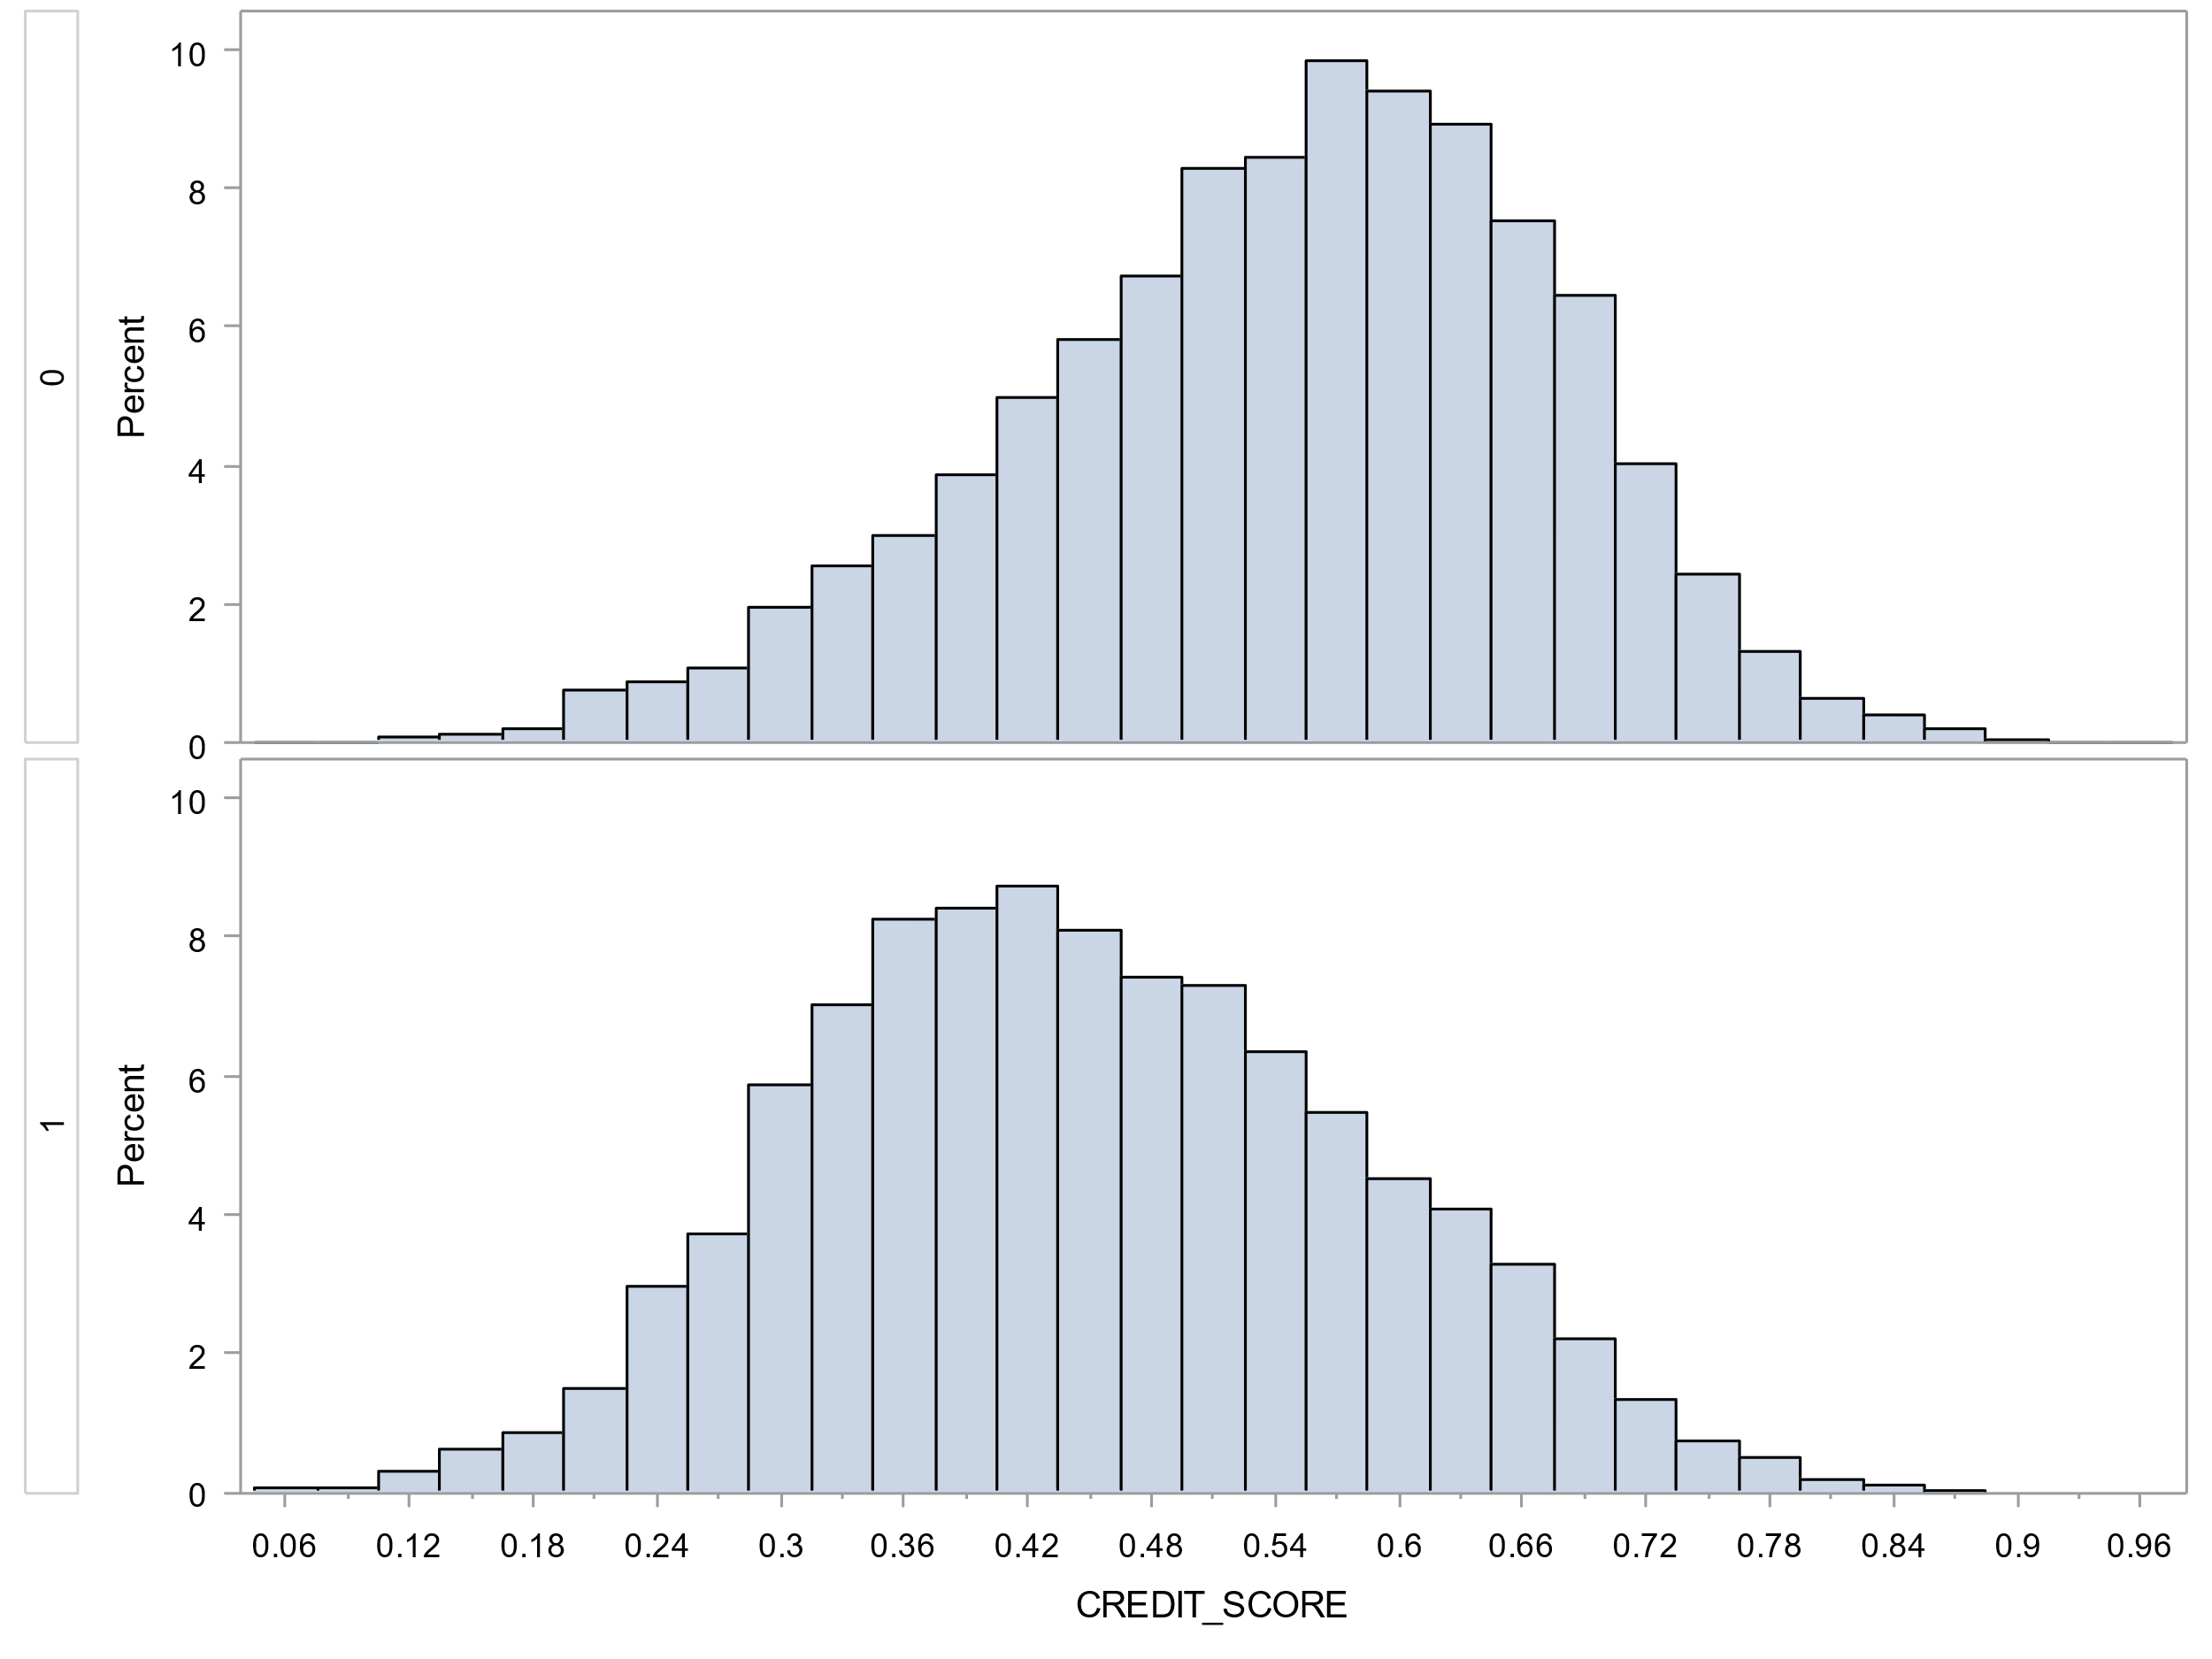
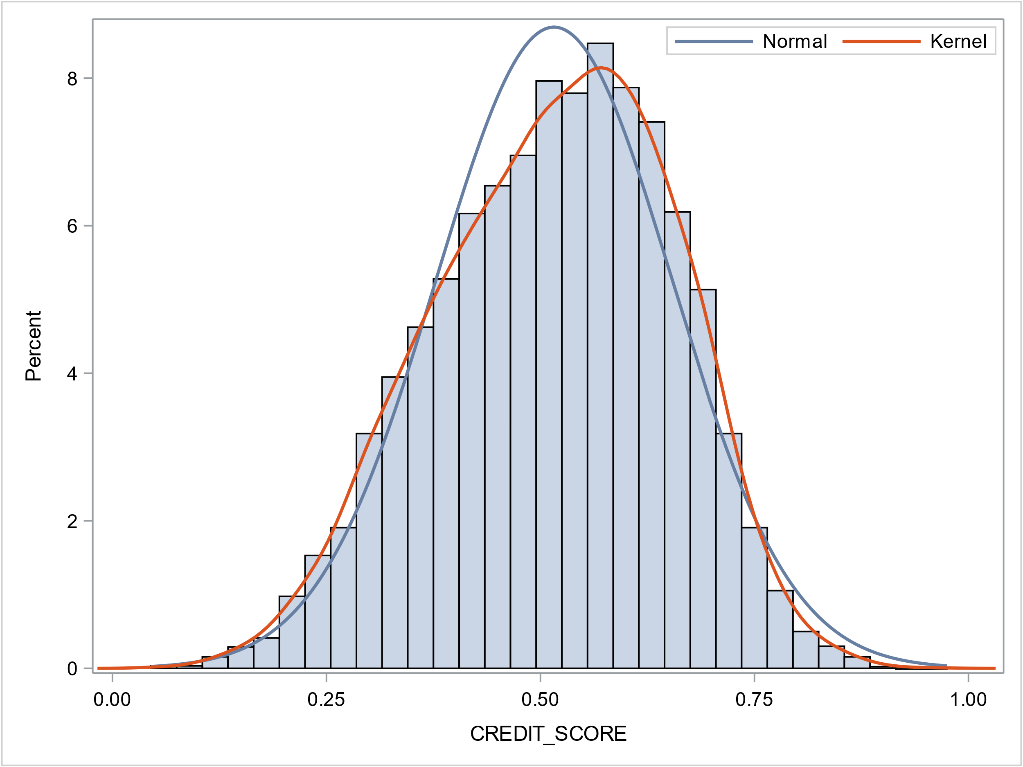
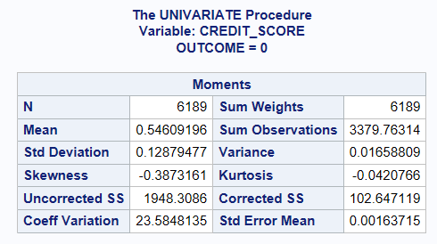
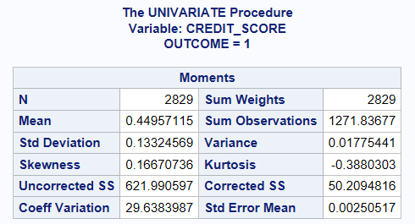
EDA – Credit Score
Close to normal distribution
Clear distinction between two outcome groups: Outcome 0: Mean credit score 0.546 Outcome 1: Mean credit score 0.450
Credit Score & Claim Outcome

Slide 6
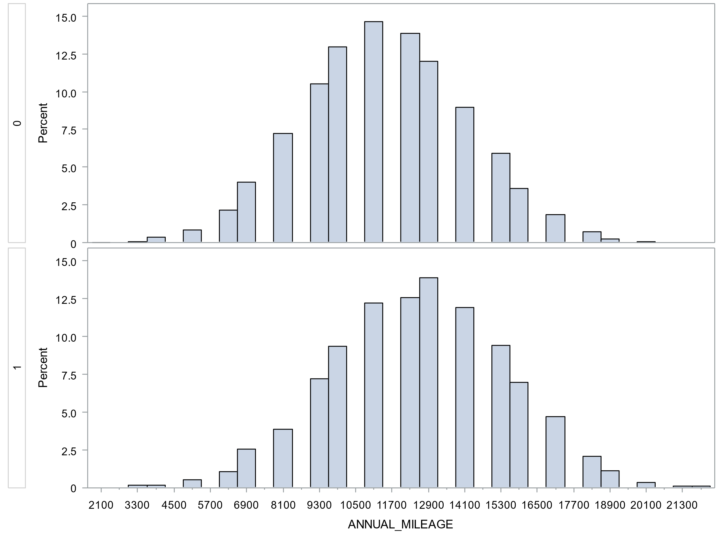
EDA – Annual Mileage
Annual Mileage & Claim Outcome
No Claim (Outcome 0): Avg. mileage ~11,343, concentrated 9,000-13,000.
Claim (Outcome 1): Avg. mileage ~12,483, wider range 8,000-14,000.
Insight: Higher annual mileage correlates with increased likelihood of insurance claims.
Due to the inaccuracy in the annual mileage reporting, this variable will be grouped into intervals

Slide 7
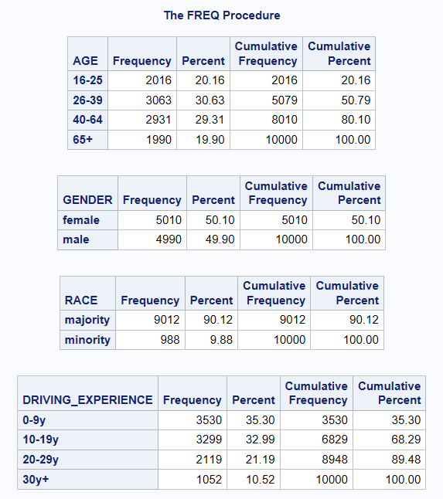
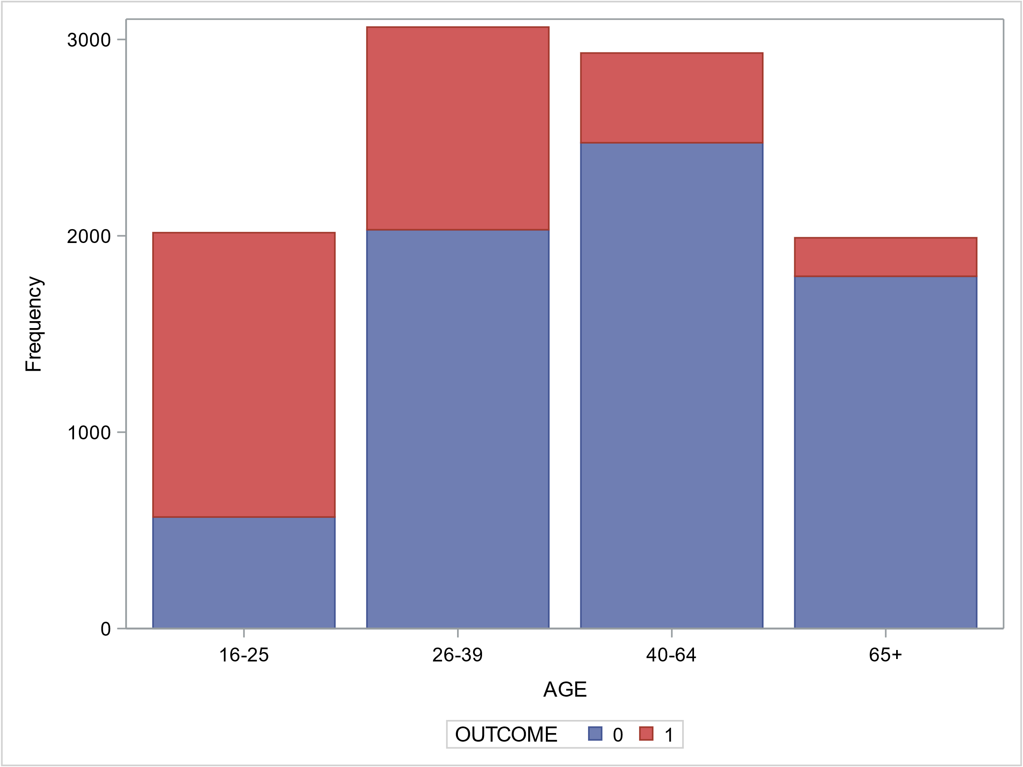
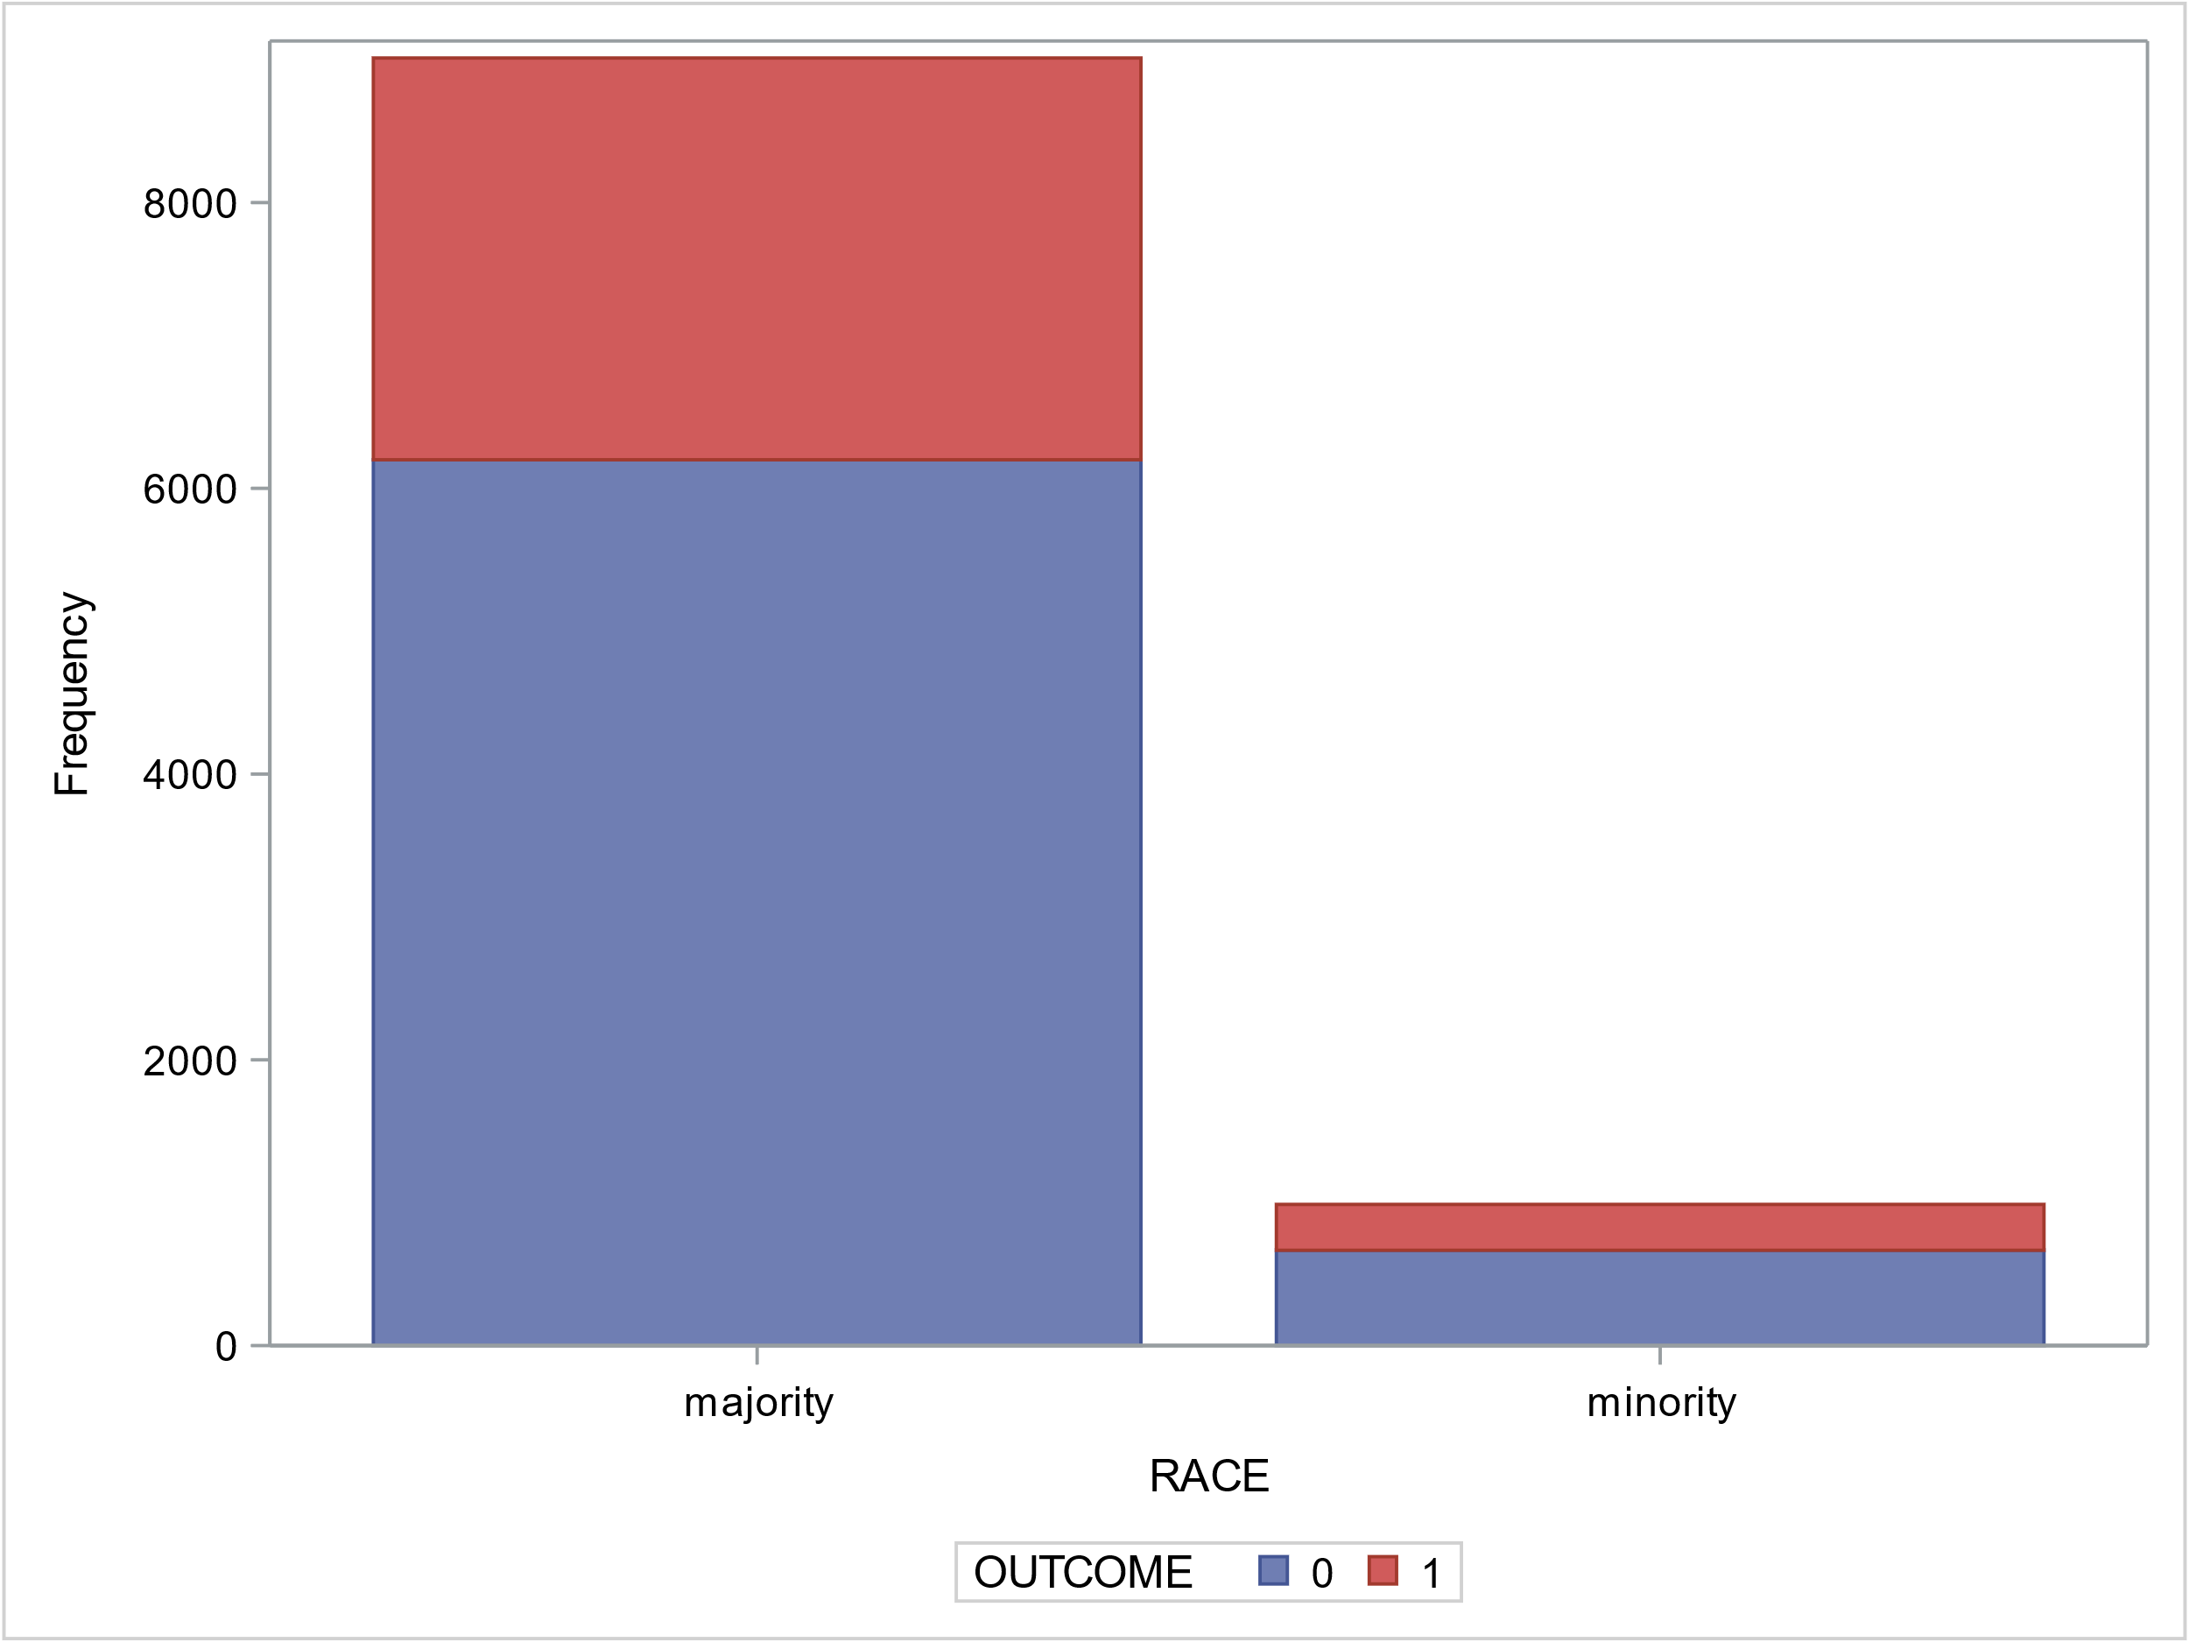
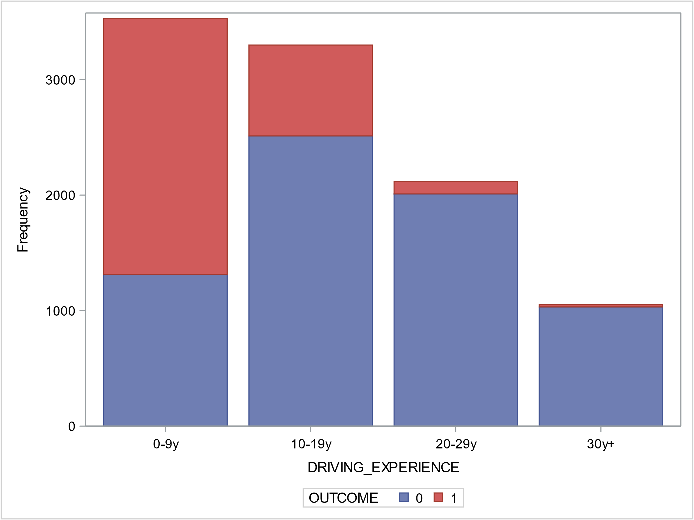
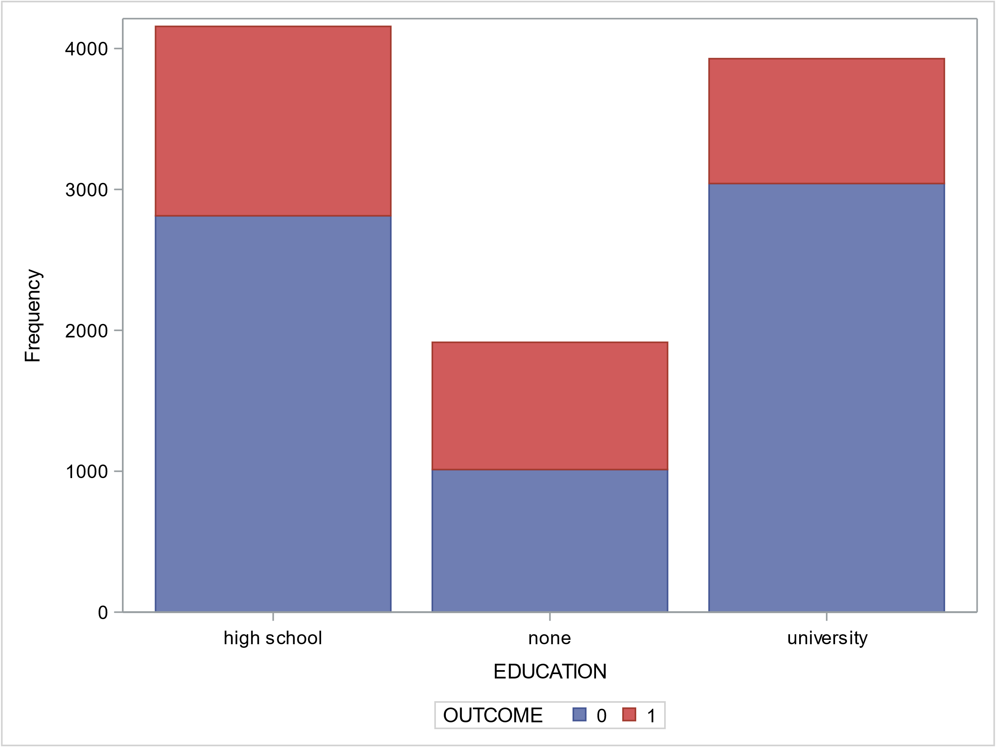
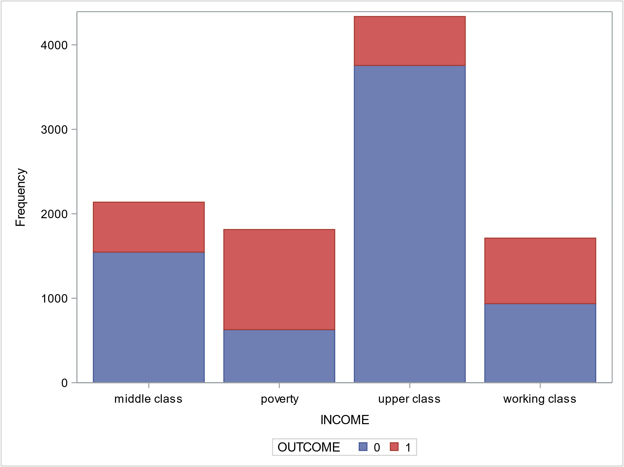
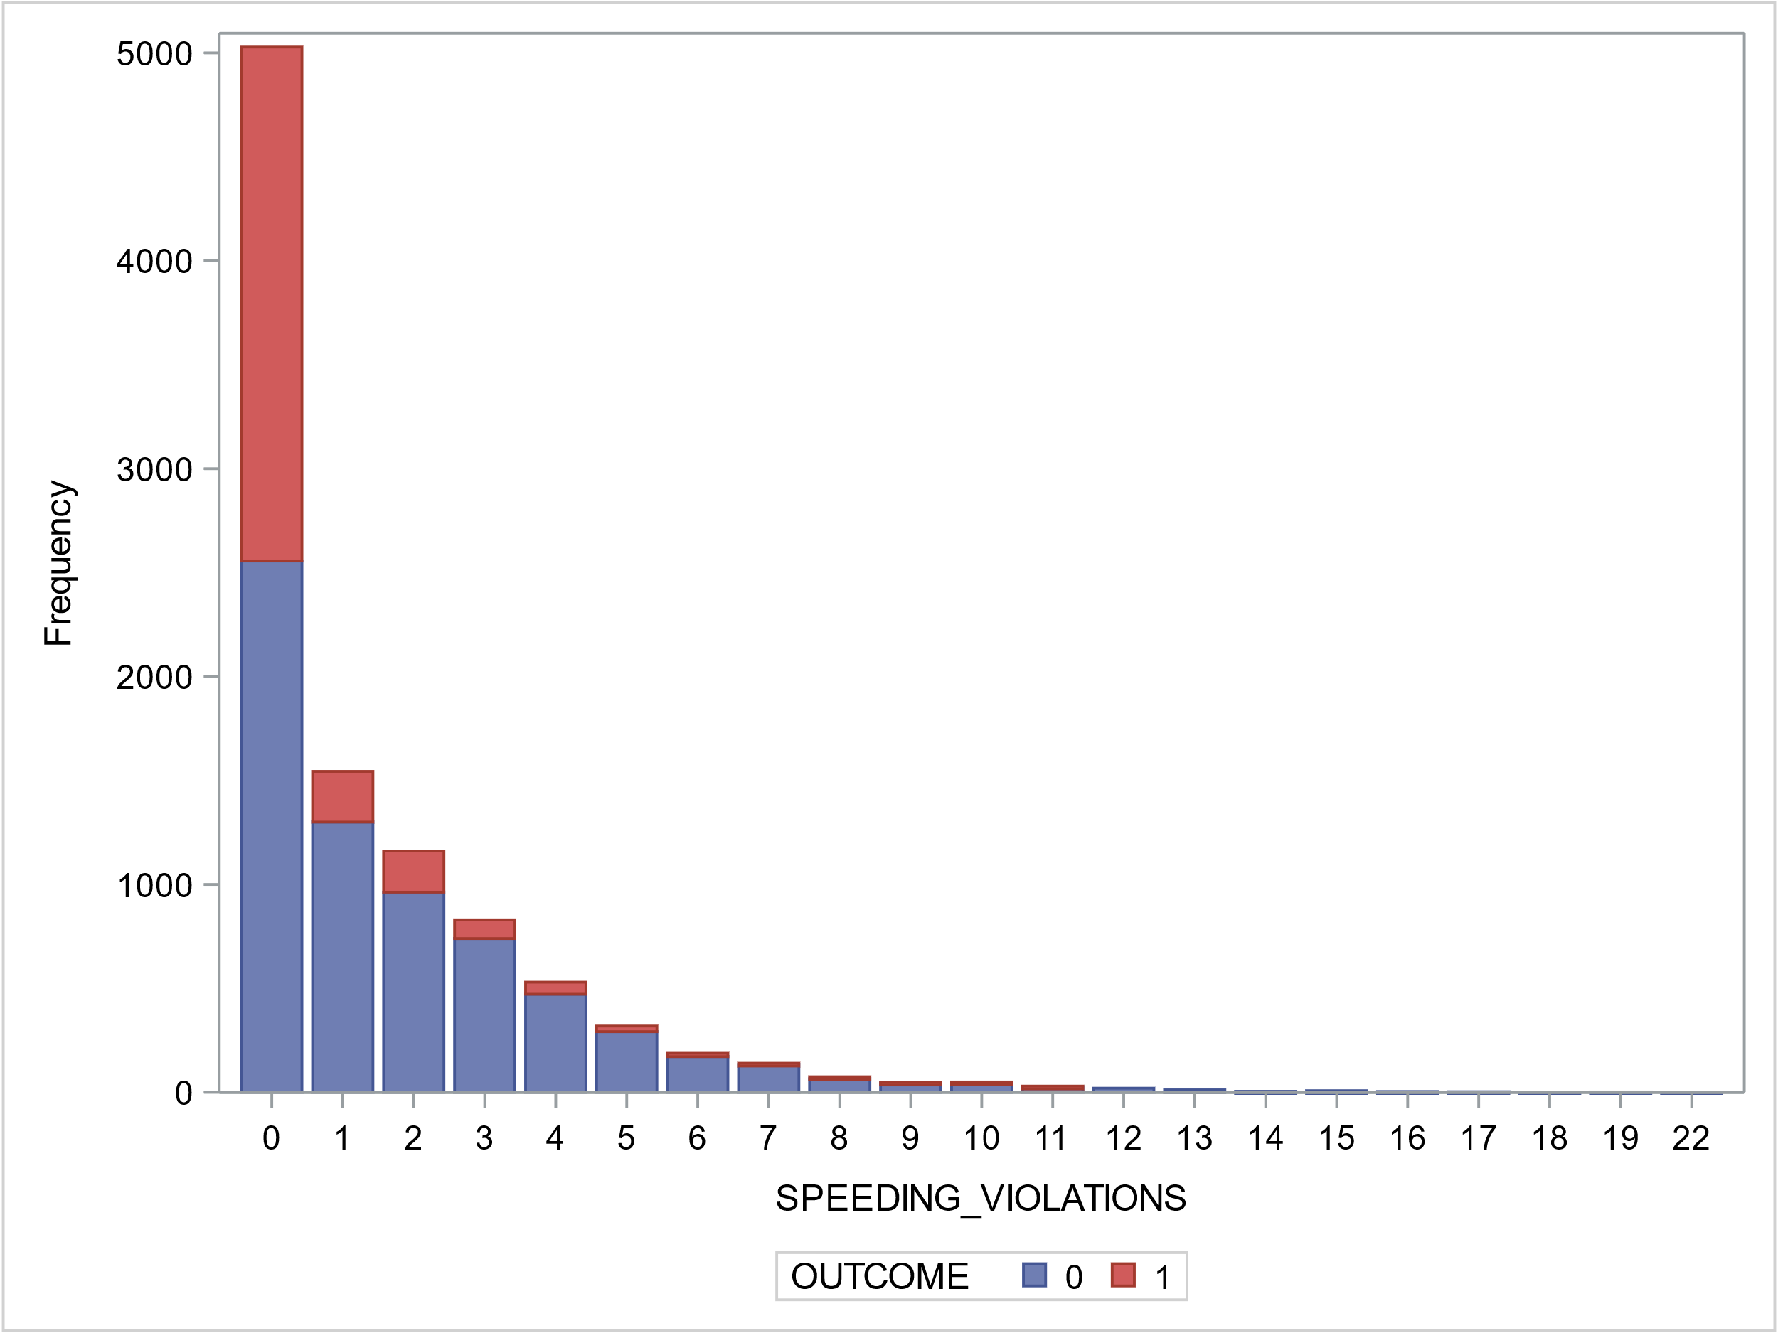
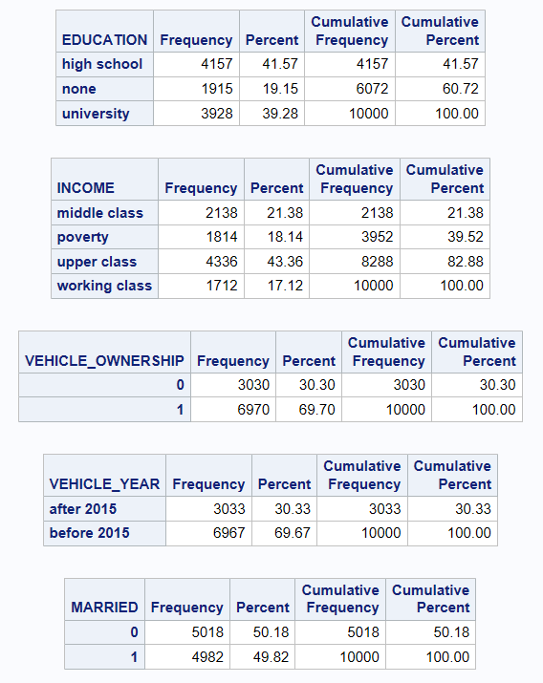
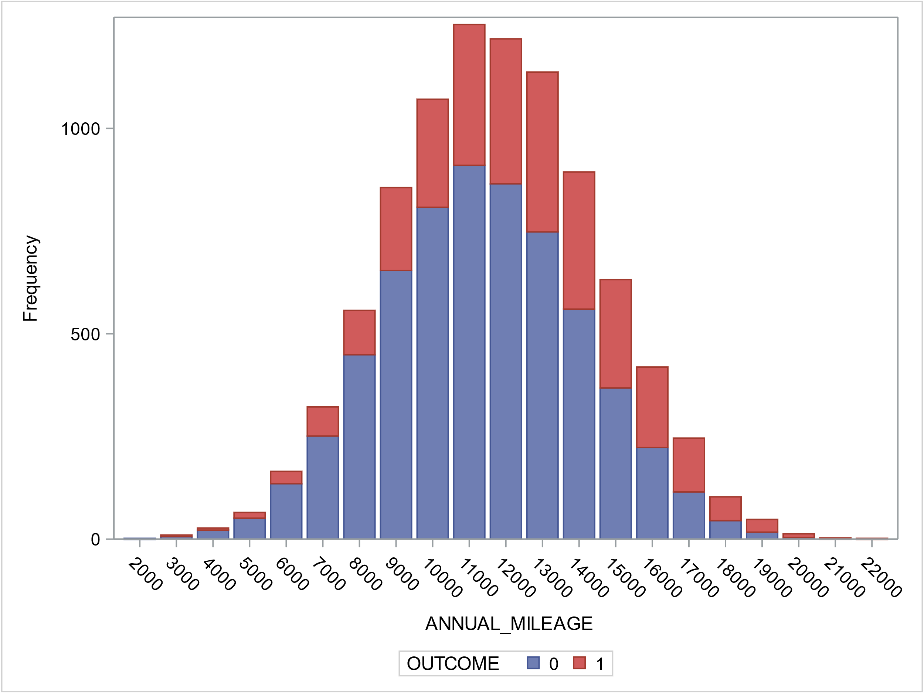
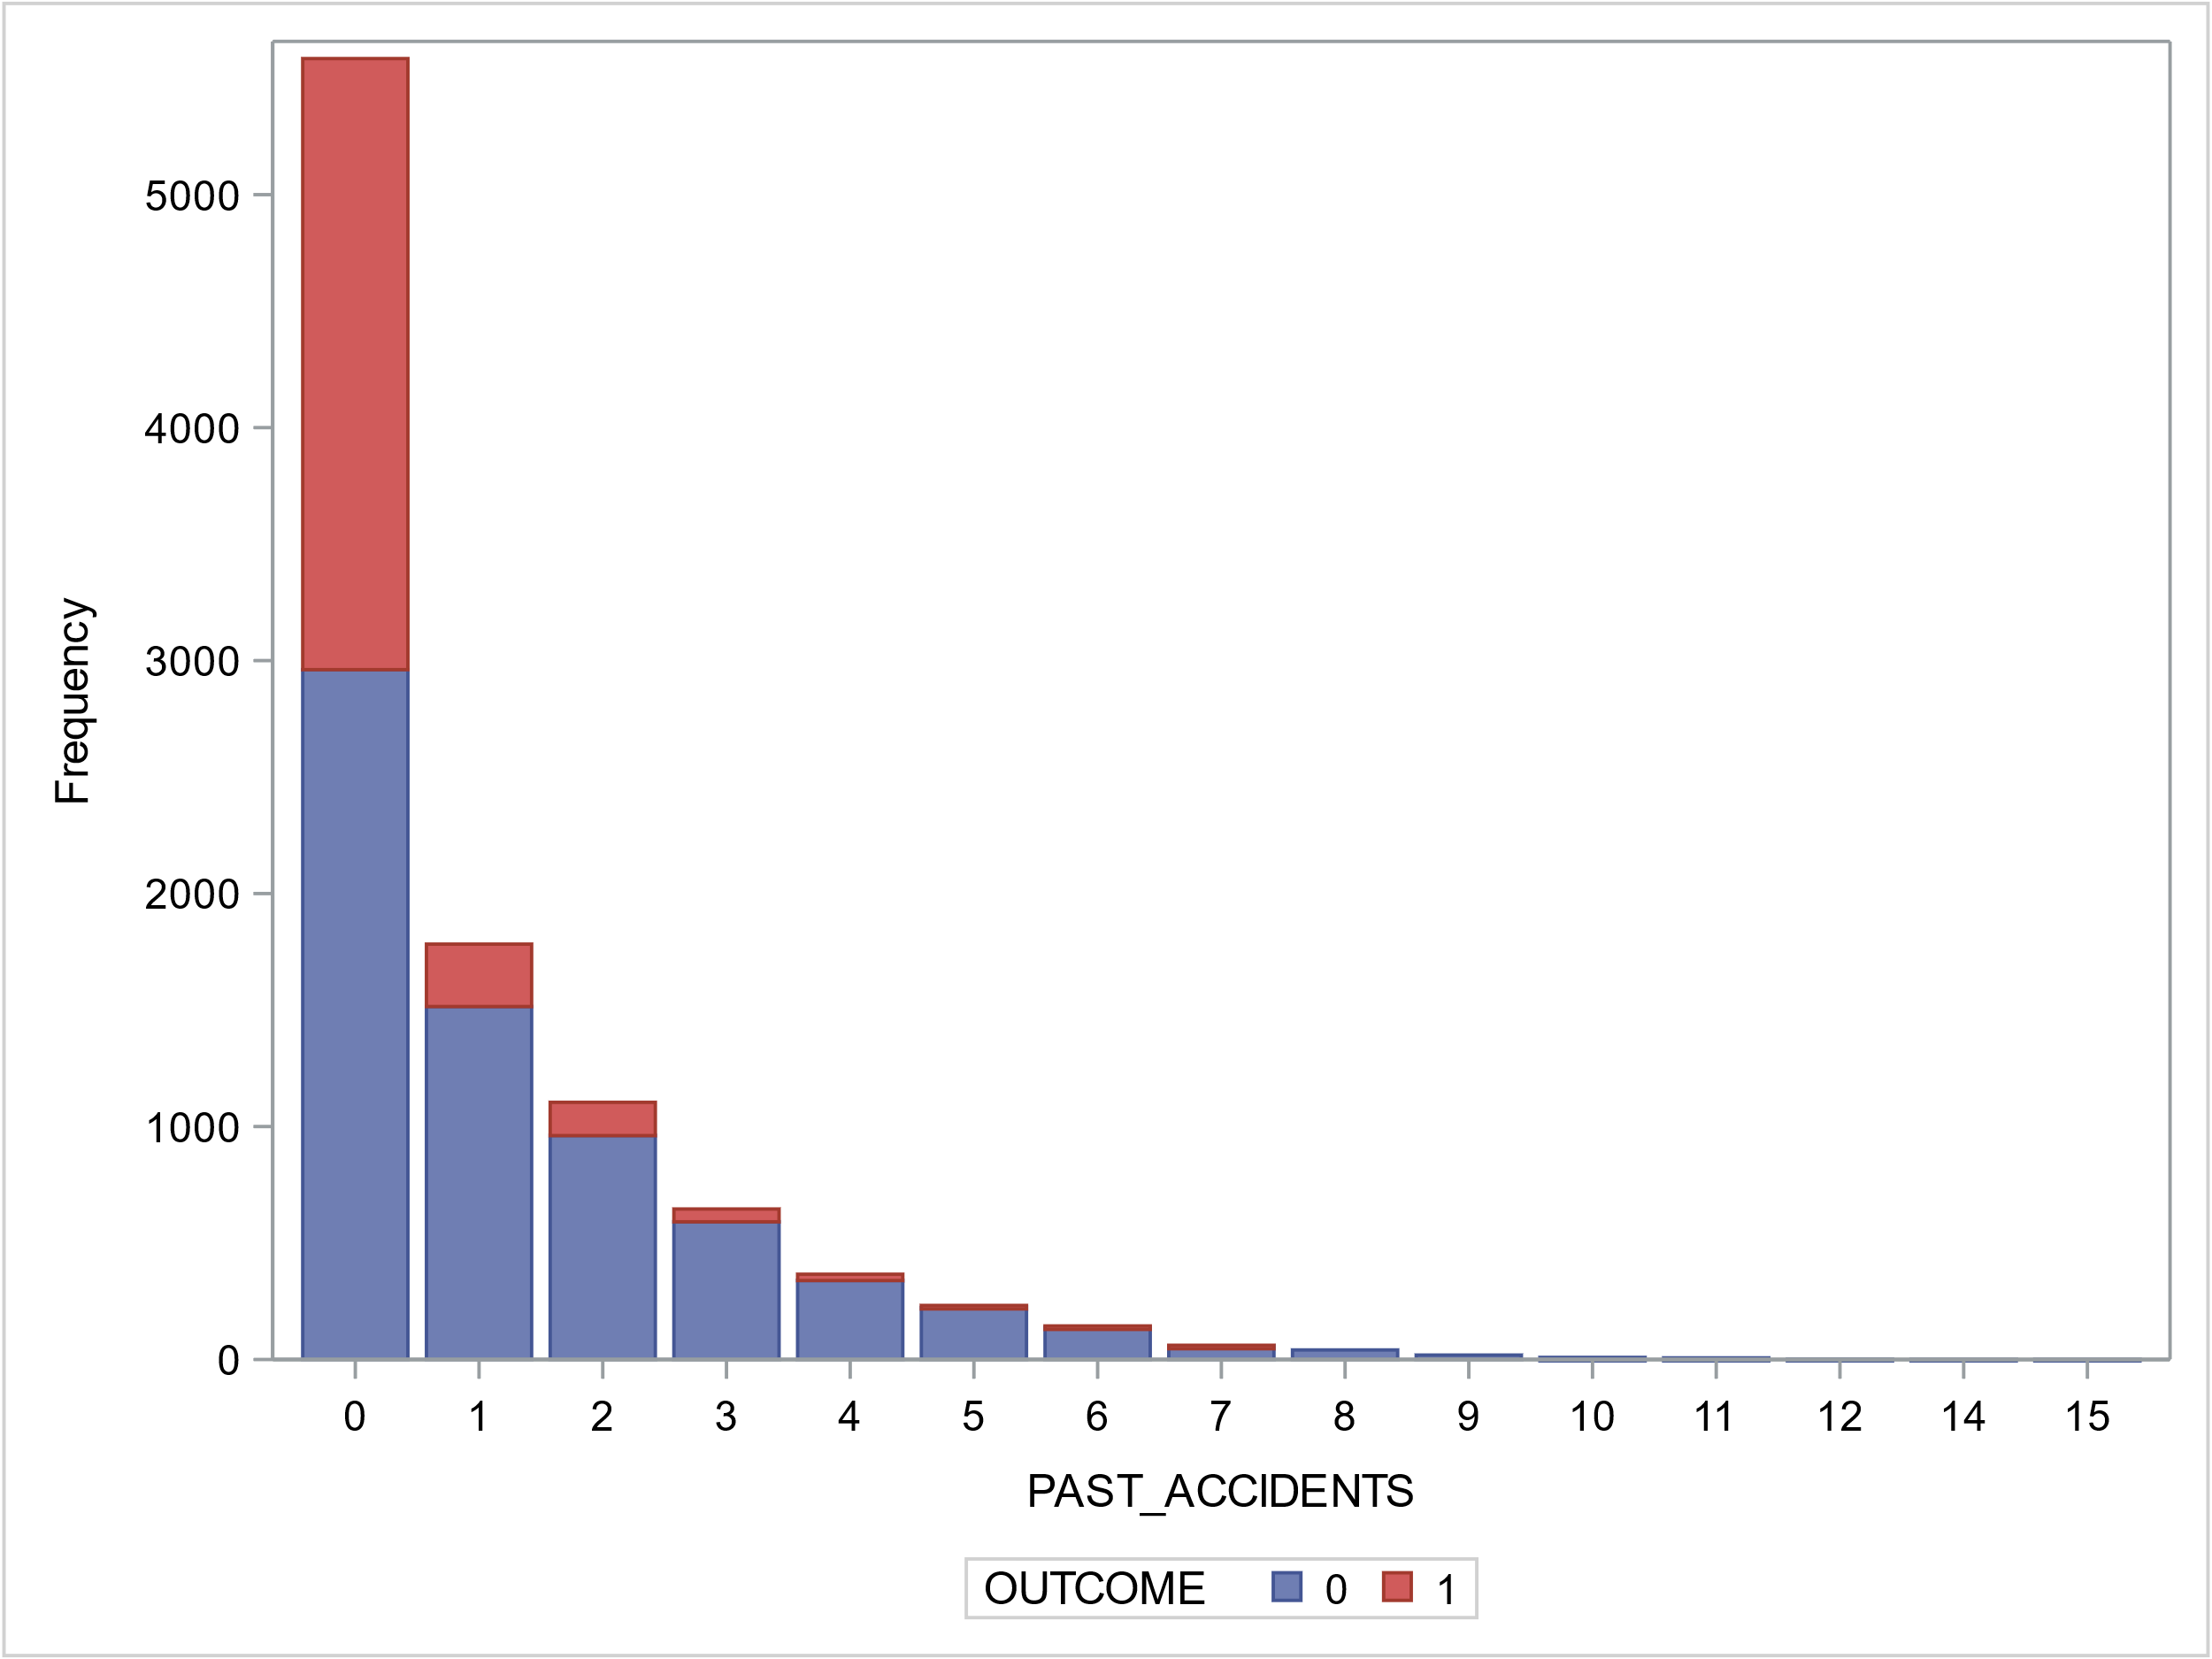
EDA – Categorical Variables

Slide 8
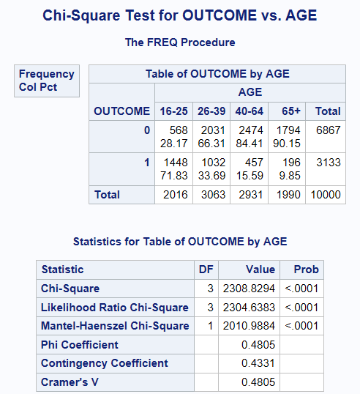
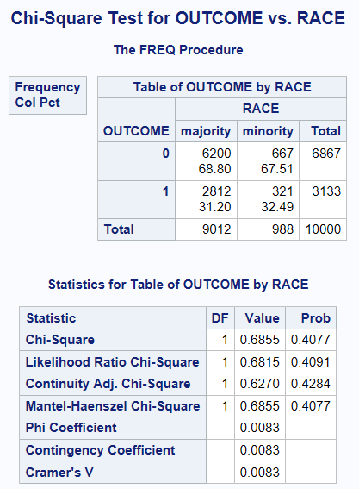
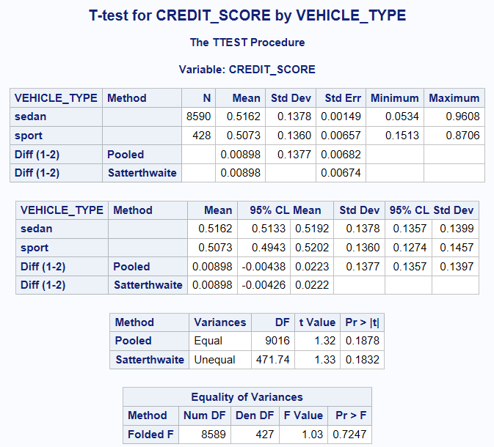
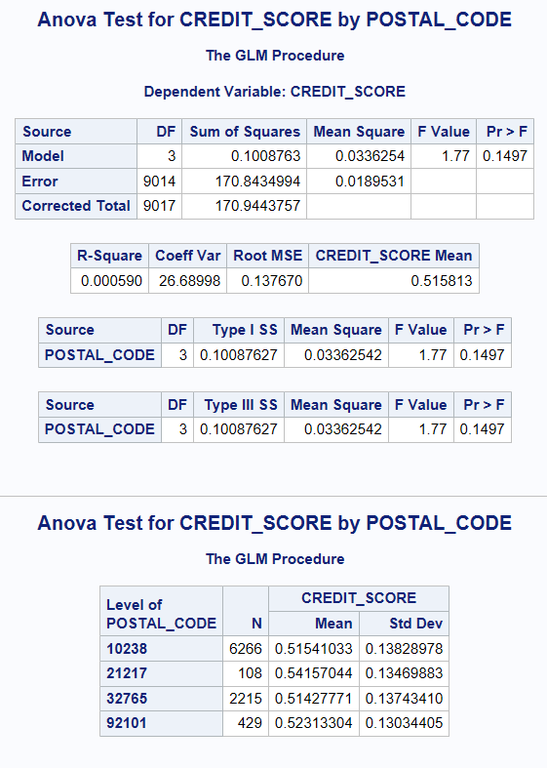
EDA – Bivariate Analysis
Categorical vs Categorical
Chi-square tests for OUTCOME against other categorical variable shows that OUTCOME is not correlated with RACE (P-val=0.41)
Continuous vs Categorical
T-test and Anova test for CREDIT_SCORE against cat variables shows that CREDIT_SCORE is not correlated with VEHICLE_TYPE and POSTAL_CODE

Slide 9
Data Preparation
Outlier Handing
Feature Engineering
Missing Value
Split Train and Test

Slide 10
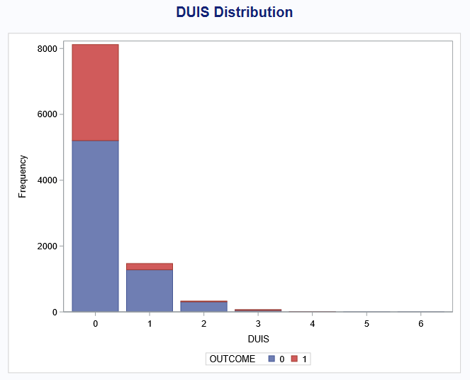
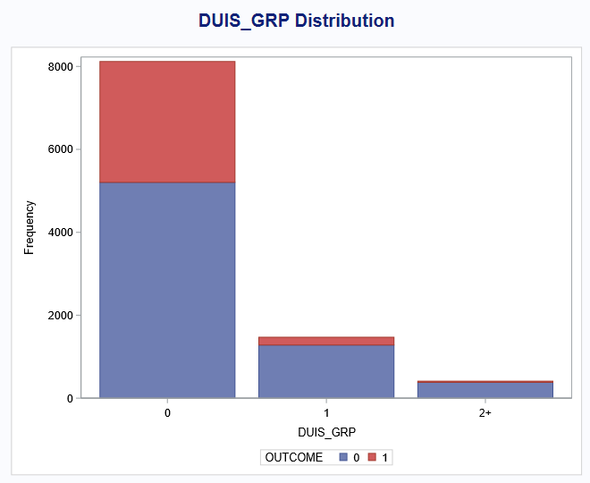
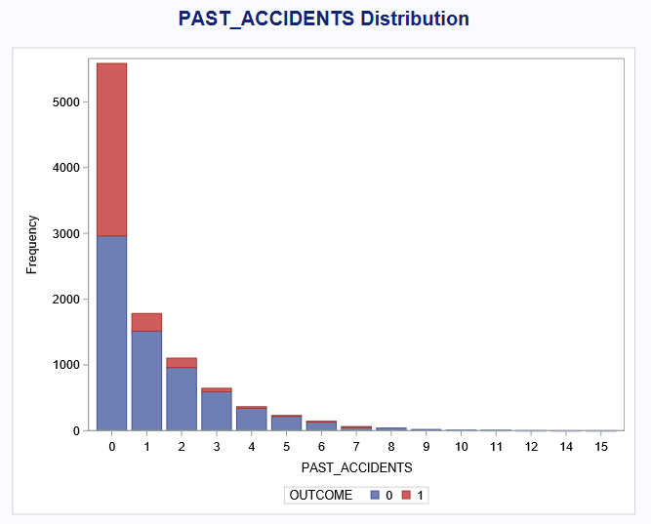
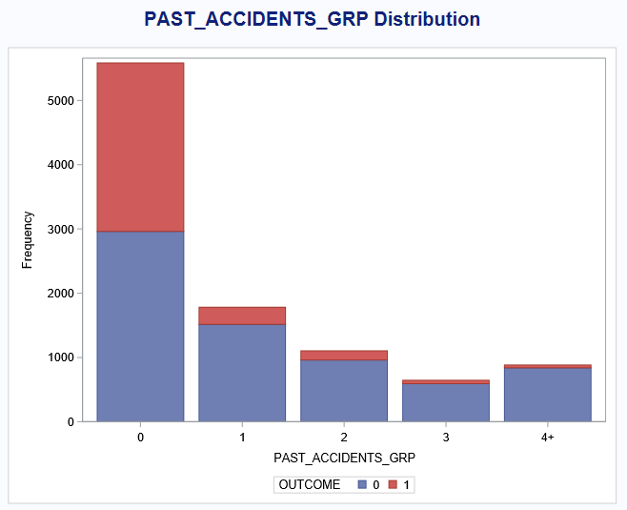
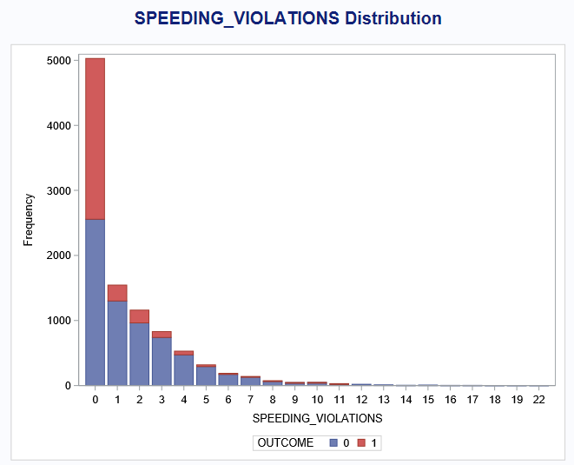
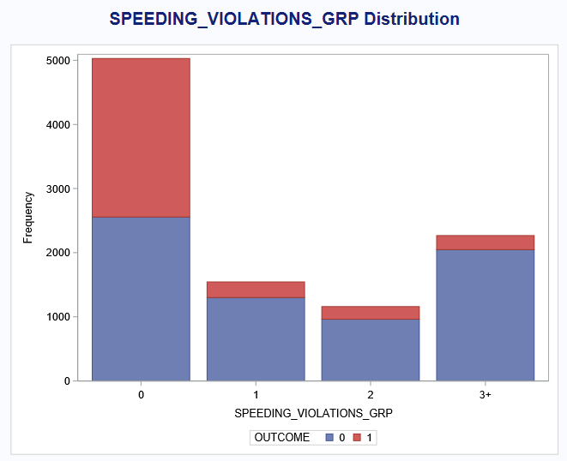
Outlier Handling
Reducing levels in DUIS, PAST_ACCIDENTS, SPEEDING_VIOLATIONS
DUIS: 0 / 1 / 2+
PAST_ACCIDENTS: 0 / 1 / 2 / 3 / 4+
SPEEDING_VIOLATIONS: 0 / 1 / 2 / 3+

Slide 11
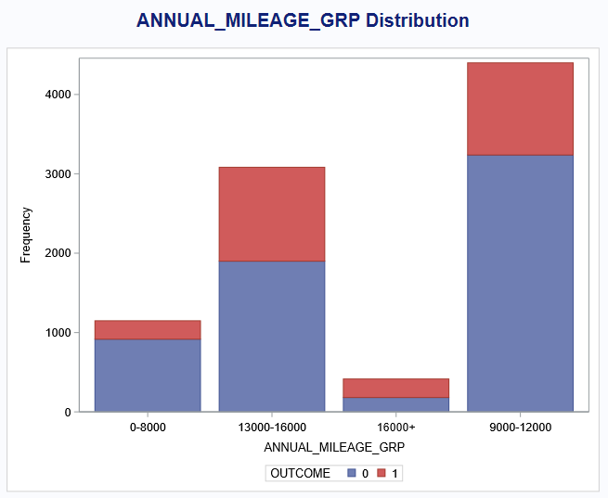
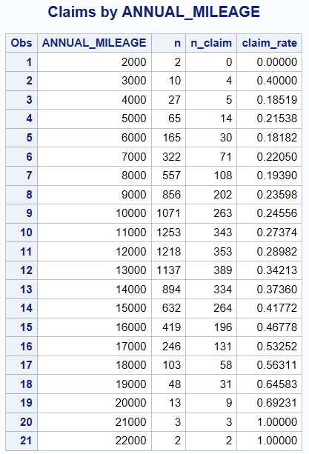
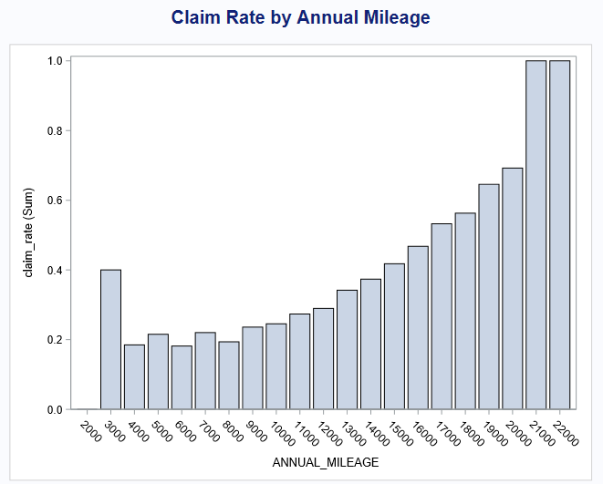
Feature Engineering
Based on number of observations and claim rate in each annual mileage
Annual mileage is grouped into 4 intervals: 0-8000 / 9000-12000 / 13000-16000 / 16000+

Slide 12
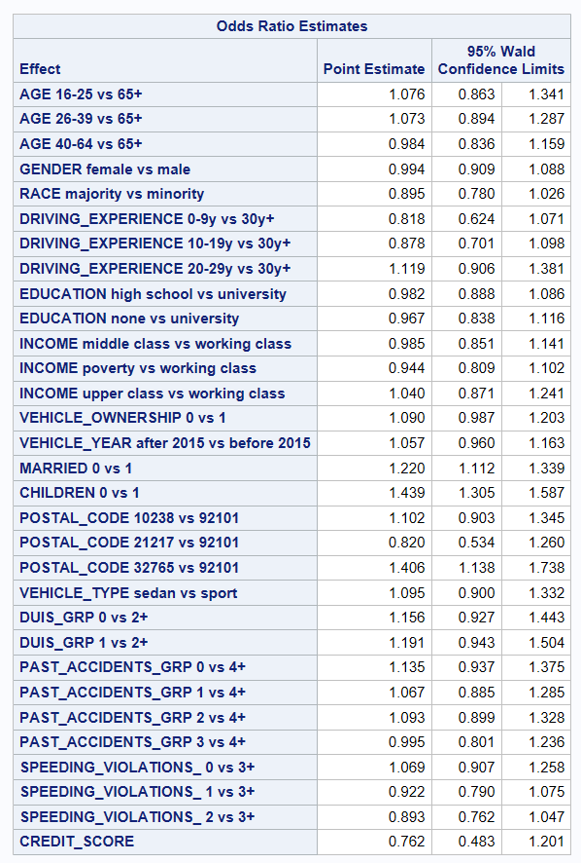
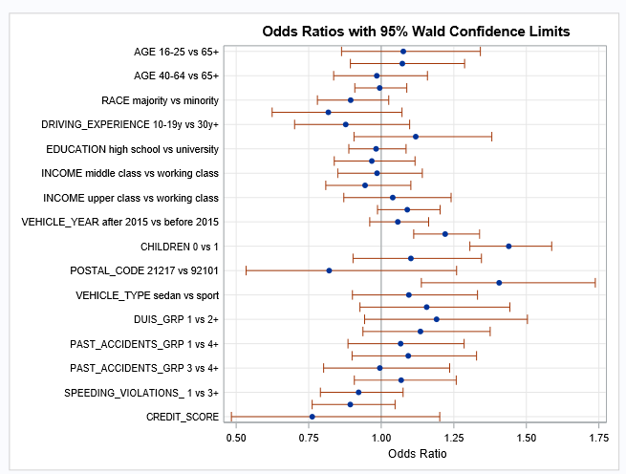
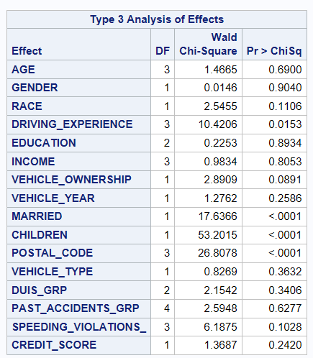
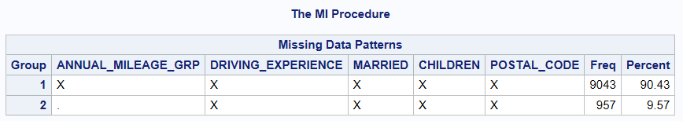
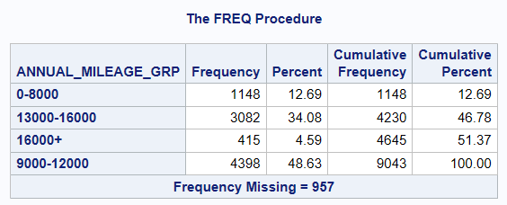
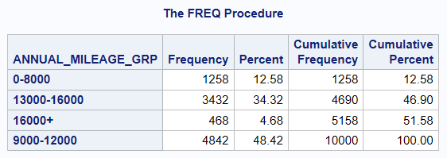
Missing Value Impute – Annual Mileage
Proc logistic model for grouped annual mileage shows it has strong correlation with variables DRIVING_EXPERIENCE, MARRID, CHILDREN, and POSTAL_CODE.

Slide 13
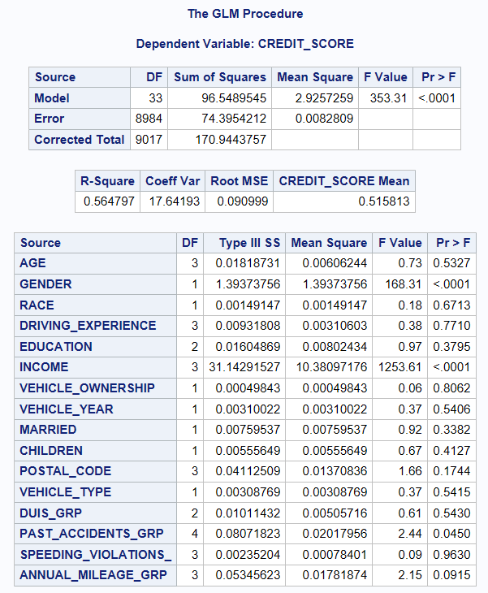
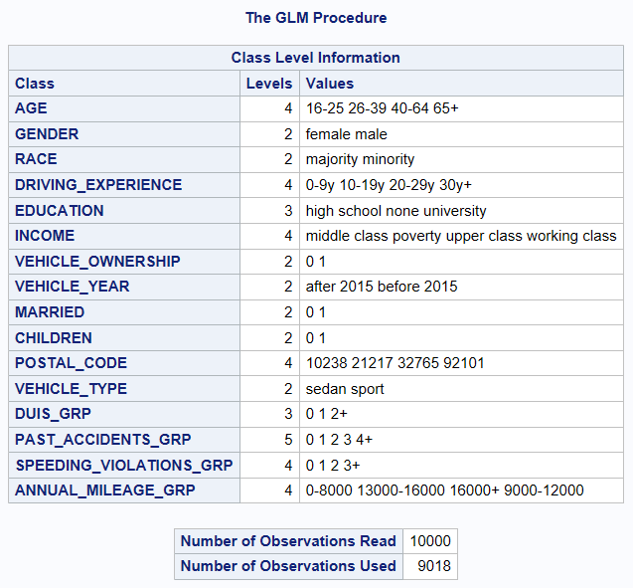
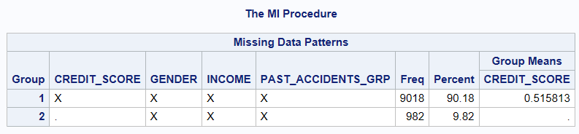
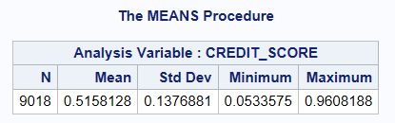
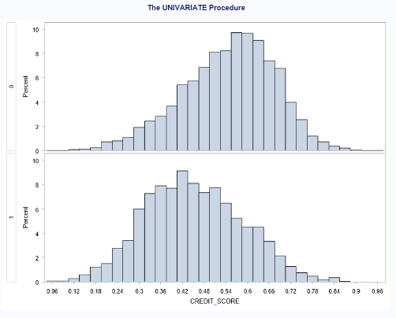
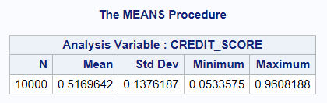
Missing Value Impute – Credit Score
Proc glm model indicates that credit score is highly correlated with GENDER, INCOME, and PAST_ACCIDENTS_GRP, with a P-value < 0.05.
These variables are used to impute the missing values in credit score

Slide 14
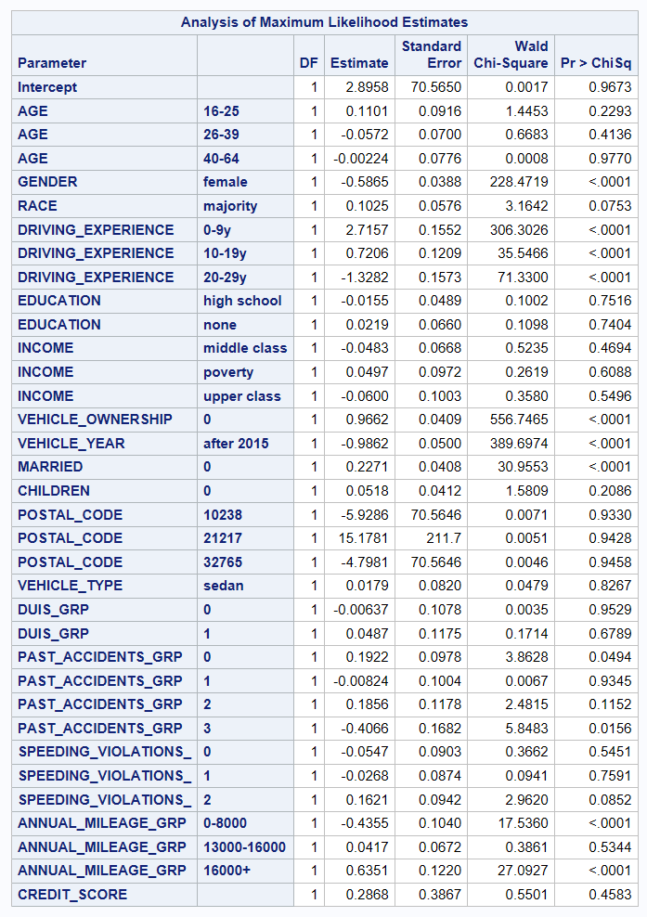
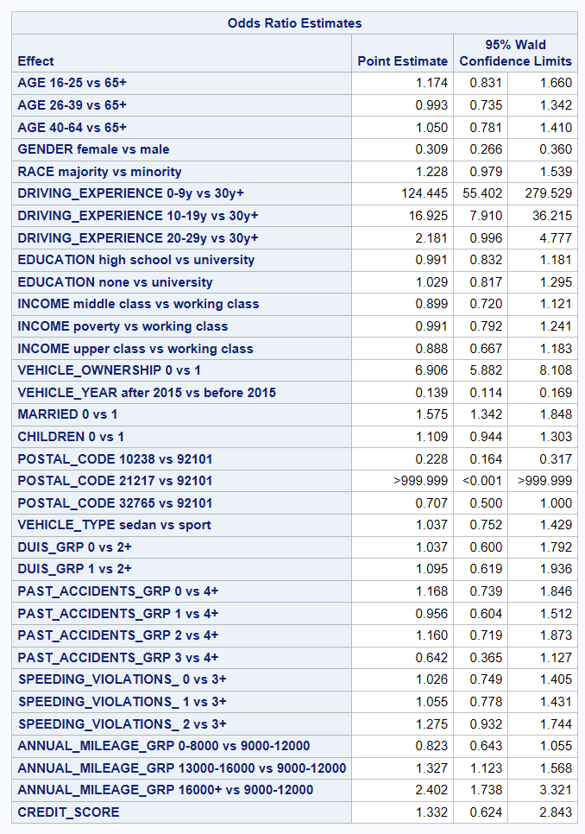
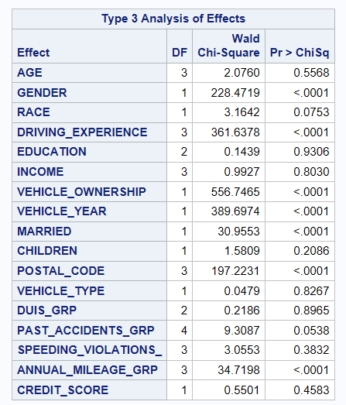
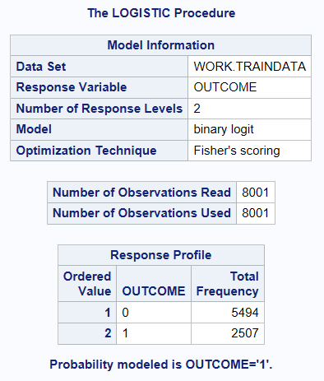
Modeling – Logistic Regression
Proc logistic model
Model shows high impact variables on outcome are gender, driving experience, vehicle ownership, vehicle year, married, postal code, and annual mileage

Slide 15
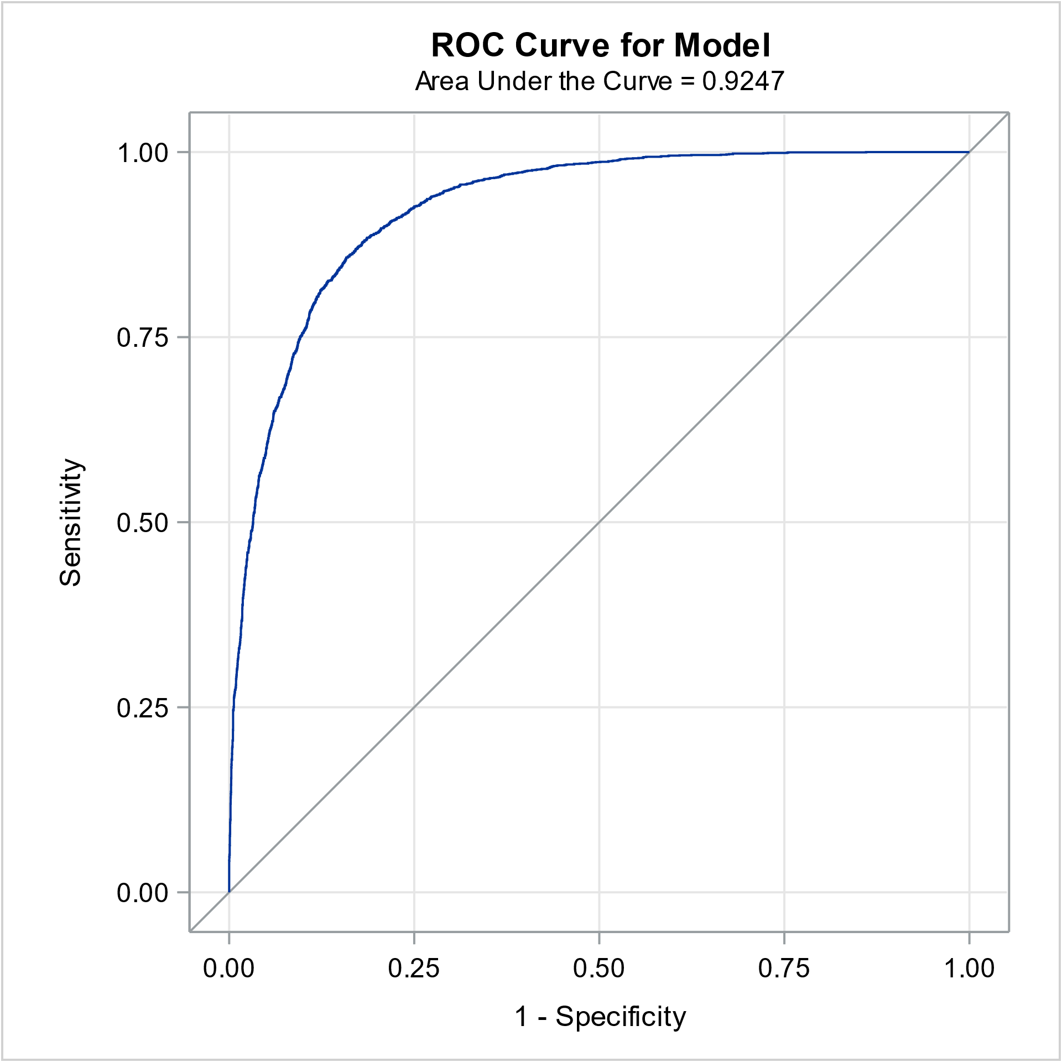
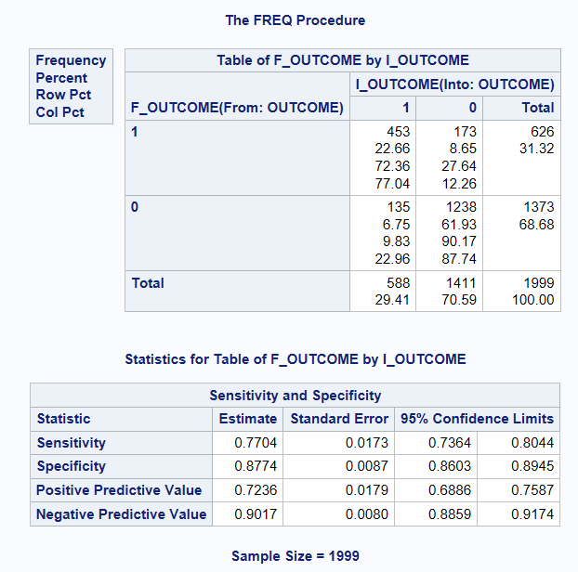
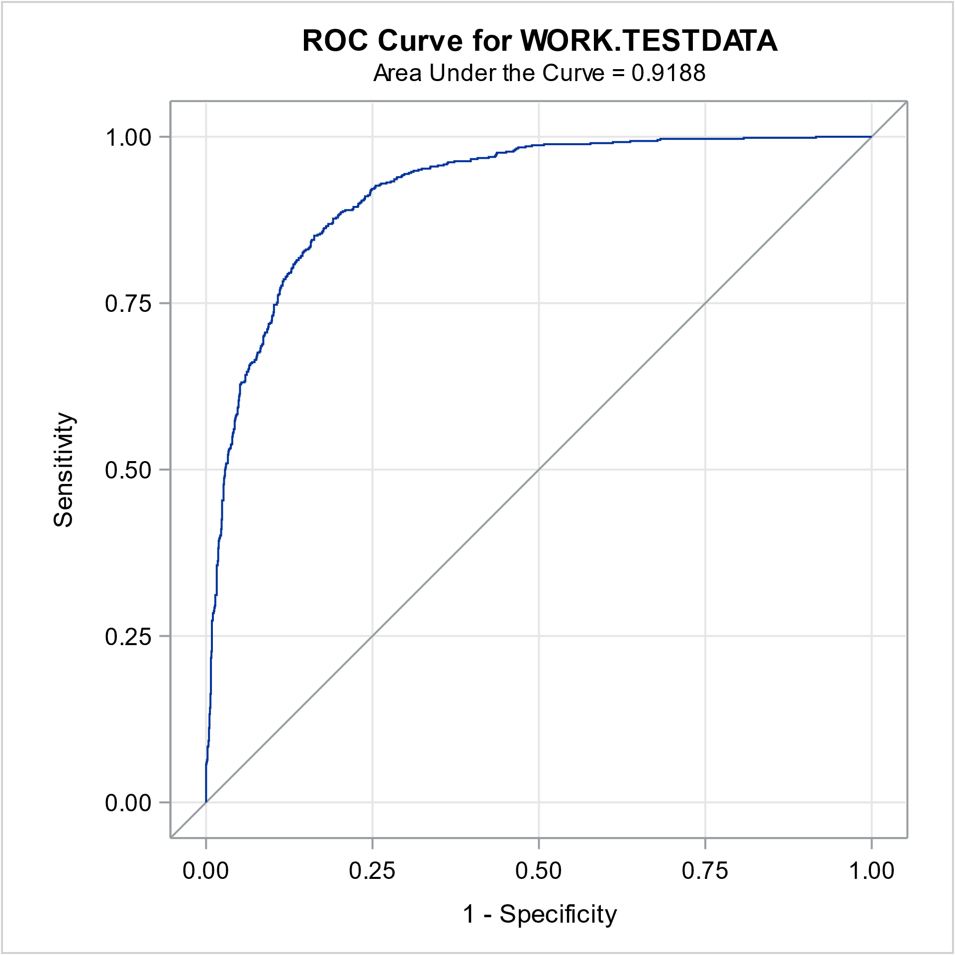
Model Evaluation
ROC-AUC score Train: 0.9247 Test: 0.9188
Sensitivity: 0.7704
Specificity: 0.8774

Slide 16

Conclusion
Logistic Model Performance:
Training Data: 0.9247
Testing Data: 0.9188
Accuracy and Overfitting:
Highly accurate with minimal overfitting.
Recall Rate (Sensitivity):
Outcome 1 (Claimed Insurance): 77%
Correctly predicts 77% of actual insurance claims.
Key predictive features:
Driving Experience: Significant (p < 0.0001), Odds Ratios: 142.113, 16.023, 2.260
Married
Children
Postal code

Slide 17

Thank you
If there is any questions?

